Slide 1
CES 361
Fundamentals of Software Testing
Lesson 23
Integration Testing

Slide 2
Quote from Book
Of the three distinct levels of testing –
unit
integration
system
integration testing is the least well understood,
and the least well done.
My question to you: Why is that?

Slide 3
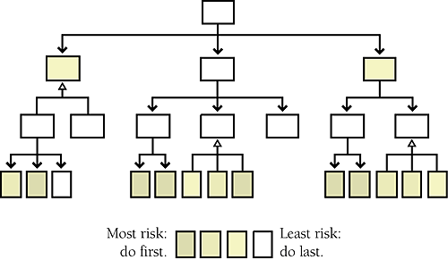
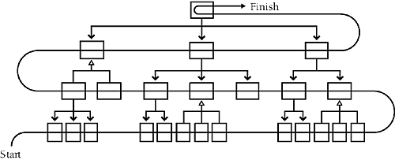
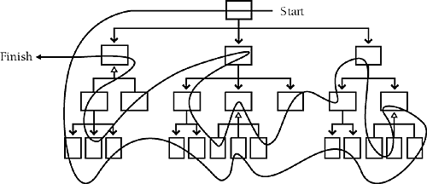
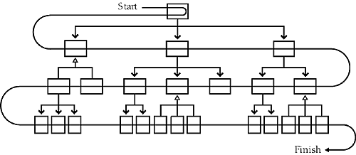
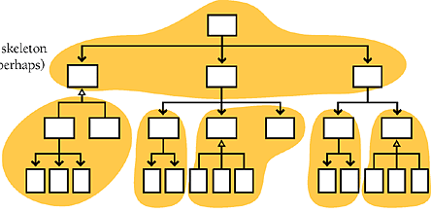

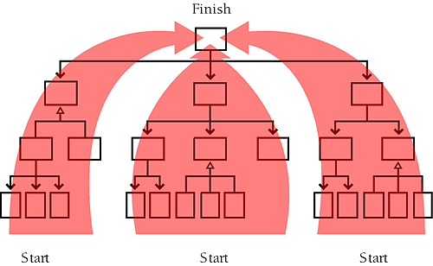
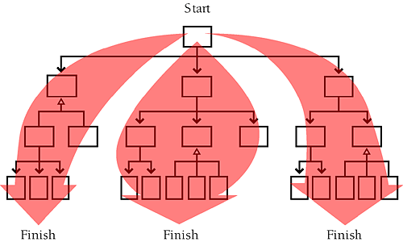
Integration Strategies
Top-down
Bottom-up
Sandwich
In sandwich integration, you integrate
top-level and widely used bottom-level
classes first, and you save middle-level
classes for last.
Risk-Driven
Integrate classes you expect
to be most troublesome first;
and implement easier classes later
Feature-Driven
http://flylib.com/books/en/2.823.1.245/1/

Slide 4
What is the main problem (or challenge) with these approaches?

Slide 5
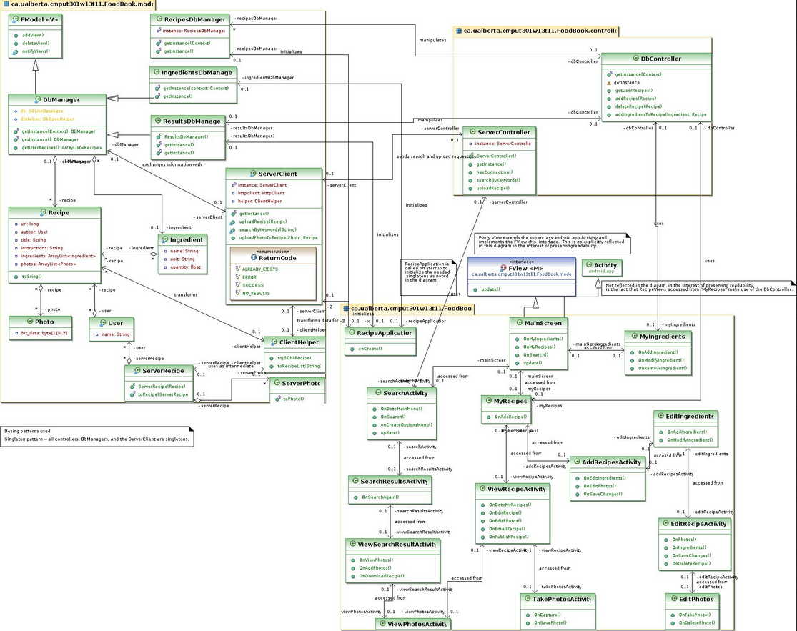
Use Case Driven
1
2
3

Slide 6
Why Test? (Part 1)
First impressions! You only have one opportunity to create a positive first impression for your end user. Adopting a technology change is difficult; you want to avoid giving your end users more reasons to resist change.
By completing a thorough testing process, the end user will see fewer “bugs” and issues.
An effective testing process will result in fewer roll outs for the users, enabling you to get it right the first time.
http://hpgresources.com/latest-thinking/key-issues-and-challenges-of-testing

Slide 7
Why Test? (Part 2)
Less rework = less time!
A commitment to quality will not result in delays but will actually increase project speed,
in addition to end user satisfaction.
If you shorten testing time, you will certainly increase go-live issues, thereby lengthening implementation.
“Testing is never a place to take a shortcut”
http://hpgresources.com/latest-thinking/key-issues-and-challenges-of-testing

Slide 8
What to Test, and How to Test It
The goal of any quality application implementation?
Provide the best possible experience for the user.
Several levels of testing are normally required in any successful testing strategy.
    This article defines 3: Unit, Integration, and Regression
A key foundation to successful integration testing is to identify issues ahead of time. Look for common build mistakes.
Use audits & metrics to find common build issues before integration testing begins.
http://hpgresources.com/latest-thinking/key-issues-and-challenges-of-testing

Slide 9
How to Test It (Part 2)
Integration testing can sometimes require a small army!
One strategy for more resources: engage end users during integration testing.
    A select group of users can be engaged; typically these users will be the designated as “mentors” to support other end users during the conversion.
  Provide the best possible experience for the user.
Independent Testing is a CIO’s best friend
    Given tight timeframes for projects and many times a shortage of skilled resources, testing is frequently performed by the same people who designed or built the software.
    While this is normal for unit testing, it is a serious flaw beyond the unit test phase.
http://hpgresources.com/latest-thinking/key-issues-and-challenges-of-testing

Slide 10

How to Test It (Part 3)
Use automated tools to support labor-intensive tasks
Detailed testing can be monotonous, repetitious, and
time-consuming.
This is necessary, but can also be a breeding ground for mistakes. Most humans are not built for long hours of repeating the same process.
Automated approaches can help solve this problem
while freeing human resources to work on more
thought-provoking problems
Automated test scripts have the ability to work around
the clock, saving the amount of time needed to test
http://hpgresources.com/latest-thinking/key-issues-and-challenges-of-testing

Slide 11
A Testing Nightmare
recent
that you’ve heard of
^
^
Can you guess my next four syllables?

Slide 12
Healthcare.gov
3 Lessons Learned
1. Performance is not an afterthought.
Failure to conduct performance testing can result in software failures and public embarrassment
Retail businesses learned that same lesson in the early days of e-commerce, when their websites failed to accommodate holiday shoppers, who had flocked online in unanticipated numbers.
Situation is worse now then it was then, because of _________ ________.
http://searchsoftwarequality.techtarget.com/feature/Avoiding-software-failures-Lessons-from-HealthCaregov

Slide 13
Healthcare.gov
3 Lessons Learned
2. Integration testing matters.
Integration testing is a given for complex applications. And virtually all systems under development today are complex systems.
Today’s information systems:
    pull information from other applications and databases created by disparate parties;
    are hosted at a wide range of locations (often in the cloud);
    often depend heavily on third-party services.
The collective operation of these services, applications and databases can have a huge impact on performance.
If the application under development has not been subjected to continuous integration testing, it simply isn't ready to go live.
http://searchsoftwarequality.techtarget.com/feature/Avoiding-software-failures-Lessons-from-HealthCaregov

Slide 14
Healthcare.gov
3 Lessons Learned
3. Finger-pointing doesn't fix broken software.
The spectacle of major software development parties pointing fingers at each other undermines the credibility of the software industry as a whole.
In the case of HealthCare.gov, company spokesmen said publicly that CGI was
not responsible for the end-to-end testing necessary to ensure the software worked. Instead, its spokespeople pointed the finger at other developers that had helped build the system.
That's the lesson for all software professionals: If an application doesn't work,
take ownership. Say it doesn't work – then work hard to fix it. Anything less is unprofessional.
http://searchsoftwarequality.techtarget.com/feature/Avoiding-software-failures-Lessons-from-HealthCaregov

Slide 15
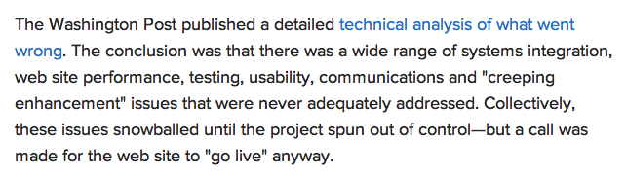
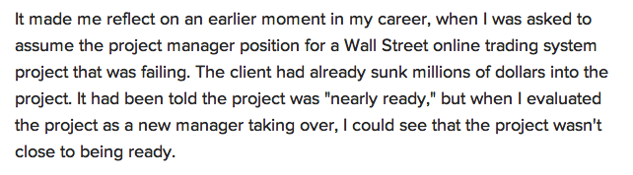
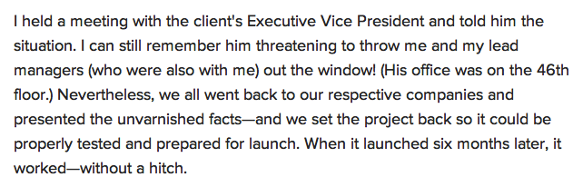
Healthcare.gov
More Lessons Learned
This lesson has stayed with me throughout my career – never let a highly visible project with so much at stake fail!
http://searchsoftwarequality.techtarget.com/feature/Avoiding-software-failures-Lessons-from-HealthCaregov

Slide 16
Healthcare.gov
More Lessons Learned
We preach testing and QA for systems, but let's face it: when project timelines get tight, stuff can get “thrown over the wall” to meet deadlines.
I've received new software releases from major technology vendors that included modules that weren't even compiled, let alone tested!
In the case of healthcare.gov, reports were already surfacing even weeks before the launch of the Website that it hadn't been properly tested.
http://www.techrepublic.com/blog/career-management/healthcaregov-web-site-launch-leaves-lessons-for-health-of-your-it-career/

Slide 17
Healthcare.gov
Testing should have occurred on several levels:
End user experience (EUE) testing to ensure that the Website was easy to use (it proved not to be)
Integration testing to ensure that 112 different systems and the efforts of 55 different vendors were all working together correctly (they weren't)
Stress testing that would have ensured that the system was sufficiently robust to handle more than the 14.6 million unique user visits that the system experienced in its first ten days of operation (it couldn't)
Some placed blame on government procurement practices that didn't emphasize key success factors needed to make a large IT project work.
Whatever the issues, a federation of 55 different contractors with no one clearly leading is too many participants to manage in a project with such heavy integration requirements.
http://www.techrepublic.com/blog/career-management/healthcaregov-web-site-launch-leaves-lessons-for-health-of-your-it-career/

Slide 18
Yikes!
The project suffered from top-level management disarray, changing systems requirements and recurring delays.
The root cause of the problems was a pivotal decision:
officials at the Centers for Medicare and Medicaid Services
would act as systems integrator, the central coordinator for
the entire program. (Usually this role is reserved for the prime information technology contractor.)
As a result, full testing of the site was delayed until four to six days before the fateful Oct. 1 launch of the health care exchanges.
http://www.washingtonexaminer.com/troubled-obamacare-website-wasnt-tested-until-a-week-before-launch/article/2537381

Slide 19
From a 30-year veteran
For a system as complex as HealthCare.gov, best practice would have led to a plan that included:
Completion and testing of all subsystems six months prior to public launch.
Three months of end-to-end functional integration testing.
Concurrent performance testing that would have simulated loads up to 10 times greater than expected (especially since it was difficult to model expected peak loads).
A subsequent three-month pilot phase in which selected groups of users were using the system to work off problems
not caught in testing.
https://fcw.com/articles/2013/11/04/healthcare-gov-rollout-what-should-we-learn.aspx

Slide 20
This is a scheduling issue as much as a testing issue
So what happened? There is pattern recognition for those of us who have been involved in many large IT programs.
First, it is difficult to accurately plan the level of effort and time to develop new systems that are composed of complex, interdependent subsystems. There should have been at least 3-6 months of schedule reserve up front.
Second,there needed to be a strong and competent program management office to oversee integration.
Third, the launch date of Oct. 1 was deemed immovable. As integration challenges mounted and development schedules slipped, there were compromises made to prevent a delayed launch. When functionality cannot be deferred, good practice is compromised. It is simply bad practice to launch a complex system with very little end-to-end testing.
There is no excuse for this! Individuals in this effort must have known this launch would not go well with inadequate testing.
https://fcw.com/articles/2013/11/04/healthcare-gov-rollout-what-should-we-learn.aspx
https://fcw.com/articles/2013/11/04/healthcare-gov-rollout-what-should-we-learn.aspx

Slide 21
Questions? Comments?
Did you get goose bumps?

Slide 22
This slide intentionally left blank

